Slide 1

The DIGITRANS Method – Fast Forward
Programme co-funded by European Union funds (ERDF)

Slide 2
Design the ideal digital shopping experience for organic lovers
3 Min (individually)
Sketch your idea here!

Slide 3
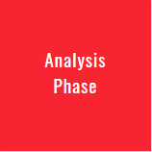
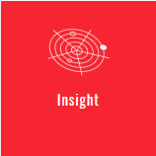
Draft the strategic landscape map with your partner
3 Min. (working in pairs)
Technology/ Legal trends
Customer trends
Competitor trends
Ongoing econo-
mic environment
Strategic Landscape Map

Slide 4
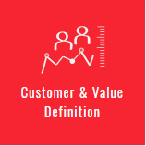
Design something useful for your partner/customer
1. Interview
8 Min (2 Sessions x 4 Minutes each) (working in pairs)
What are your partner‘s tasks? (Jobs)
What are your partner‘s challenges (Pains)
What is your partner‘s benefit? (Gains)
Conduct an Interview
Value Proposition Canvas
2. Dig deeper & ask further questions
6 Min (2 Sessions x 3 Minutes each) (working in pairs)

Slide 5
Reframe the problem
3. Capture findings
3 Min (individually)
Goals & Wishes: What is your partner trying to achieve?
Insights: New learnings about your partner‘s feelings and motivations. What‘s something you see about your partner‘s experience that maybe s/he doesn‘t see?
Value Proposition Canvas
Persona
4. Take a stand with a Point-of-View
3 Min (individually)
_________________(Partner‘s name/ description)
needs a way to __________________________________ (user‘s needs)
because (or „but…“or “surprisingly …“)
____________________________________________________________________________________________________________________________________________________________________________ (Insight)

Slide 6
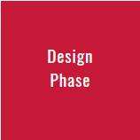
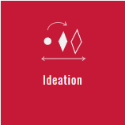
Ideate: generate digital solutions to test
5. Draft at least 5 radical ways that meet your partner‘s needs
5 Min (individually)
Brainstorming; Brainwriting
6. Share your solutions and capture feedback
10 Min (2 Sessions x 5 Minutes each) (working in pairs)
Testing; Idea Selection

Slide 7
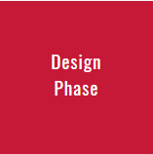
Iterate based on the feedback
7. Reflect & generate a new digital solution.
How could the cost and revenue structure look like?
3 Min (individually)
Brainstorming
Idea Selection
Business Model Canvas
Iterative Working Style

Slide 8
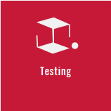
Build and test
8. Design your digital solution
Make something your partner can interact with!
7 Min (individually)
SAP Scenes
Scene2model
Business Model Canvas
Handcrafted Prototypes
9. Share your digital solution & get feedback
8 Min (2 Sessions x 4 Minutes each) (working in pairs)
Testing
Feedback Collection Grid
What worked?
What could be improved?
Not here!
Ideas …
Questions

Slide 9
Reflect your work
10. Formulate next steps
2 Min (individually)
Based on the feedback received – which two aspects
would you realize next?
1)
2)
11. Redefine the Point-of-View
3 Min (individually)
How has your point-of-view from step 5 changed through
the interaction? Draft a new Point-of-view based on
the information gained.

Slide 10






Contact
Petra Newrly
MFG Baden-Württemberg
newrly@mfg.de
0049-711-90715357
Martin Kinitzki
Herman Hollerith Zentrum
Martin.Kinitzki@Reutlingen-University.DE
0049-176-42021189
www.interreg-danube.eu/digitrans
https://digitrans.me
facebook.com/digitransEU
bit.ly/digitransme
#DigitransEU
Unless otherwise stated, the presentation “DIGITRANS method – a short overview” of the DIGITRANS Project, hosted by Martin Kinitzki und Petra Newrly, is licensed under the Creative Commons Attribution-Non-Commercial-ShareAlike 4.0 International License. You can find a copy of the license here https://creativecommons.org/licenses/by-nc-sa/4.0/deed.de
The presentation based on the work „An Introduction in Design Thinking“ by HASSO PLATTNER Institute of Design at Stanford licensed under CC BY- Non NC- SA.
The European Commission support for the production of this publication does not constitute an endorsement of the contents which reflects the views only of the authors, and the Commission cannot be held responsible for any use which may be made of the information contained therein.

